Slide 1
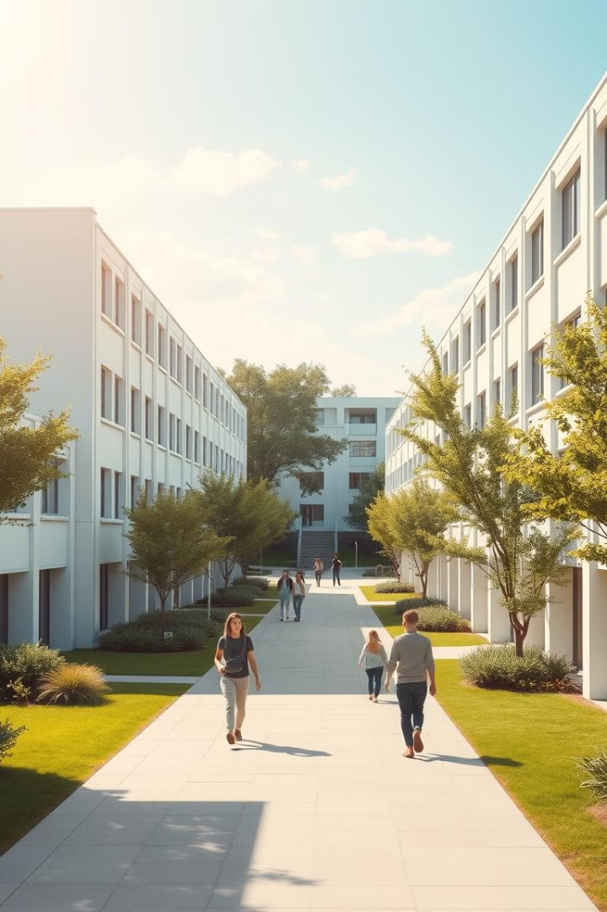
Hostel Management System: Streamlining Student and Warden Experiences
This comprehensive hostel management system empowers both students and wardens, providing secure access, personalized experiences, and efficient administrative tools to enhance life on campus.

Slide 2
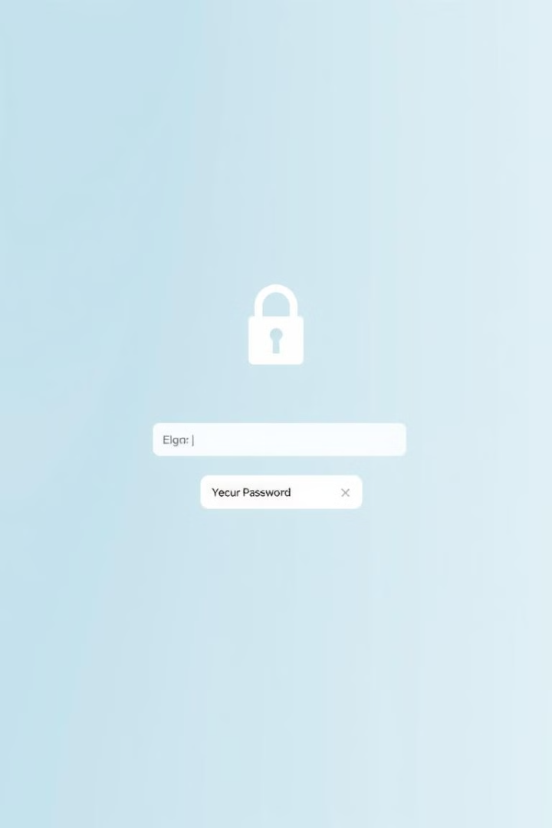
Login Page: Secure Access for Students and Wardens
1
Secure Authentication
Students and wardens can securely log in using unique credentials, ensuring privacy and data protection.
2
Personalized Dashboards
Upon successful login, users are directed to their respective portals tailored to their roles and needs.
3
Seamless Access
The login page provides a centralized gateway to the entire hostel management system.

Slide 3
Student Portal: View Profile, Pay Fees, Request Gate Pass
View Profile
Pay Fees
Request Gate Pass
Students can access and view their personal information, such as room allocation and contact details.
Students can conveniently pay their hostel fees online, with options for partial or full payments.
Students can submit gate pass requests for approved exits, streamlining the process for wardens.

Slide 4


Student Feedback: Improving Hostel Experiences
Voice Your Opinions
Students can share their thoughts, concerns, and suggestions to enhance their overall hostel experience.
Continuous Improvement
By actively listening to student feedback, the hostel management can implement targeted improvements.

Slide 5
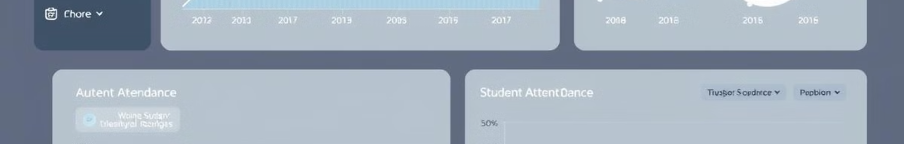
Data Analytics: Insights for Efficient Hostel Management
Review Gate Passes
Manage Enrollment
Wardens can efficiently review and approve or deny student gate pass requests, ensuring campus security.
Wardens can add new students, update their details, and maintain a comprehensive student database.
1
2
3
4
Fee Payment Analysis
Feedback check
Monitor fee payment patterns to identify any outstanding dues and alert students via email
Can view the students feedback about the hostel and do the necessary

Slide 6

Database Contents
We have used five tables
Login Table
Check out Table
Fee Table
Student Table
Feedback Table

Slide 7
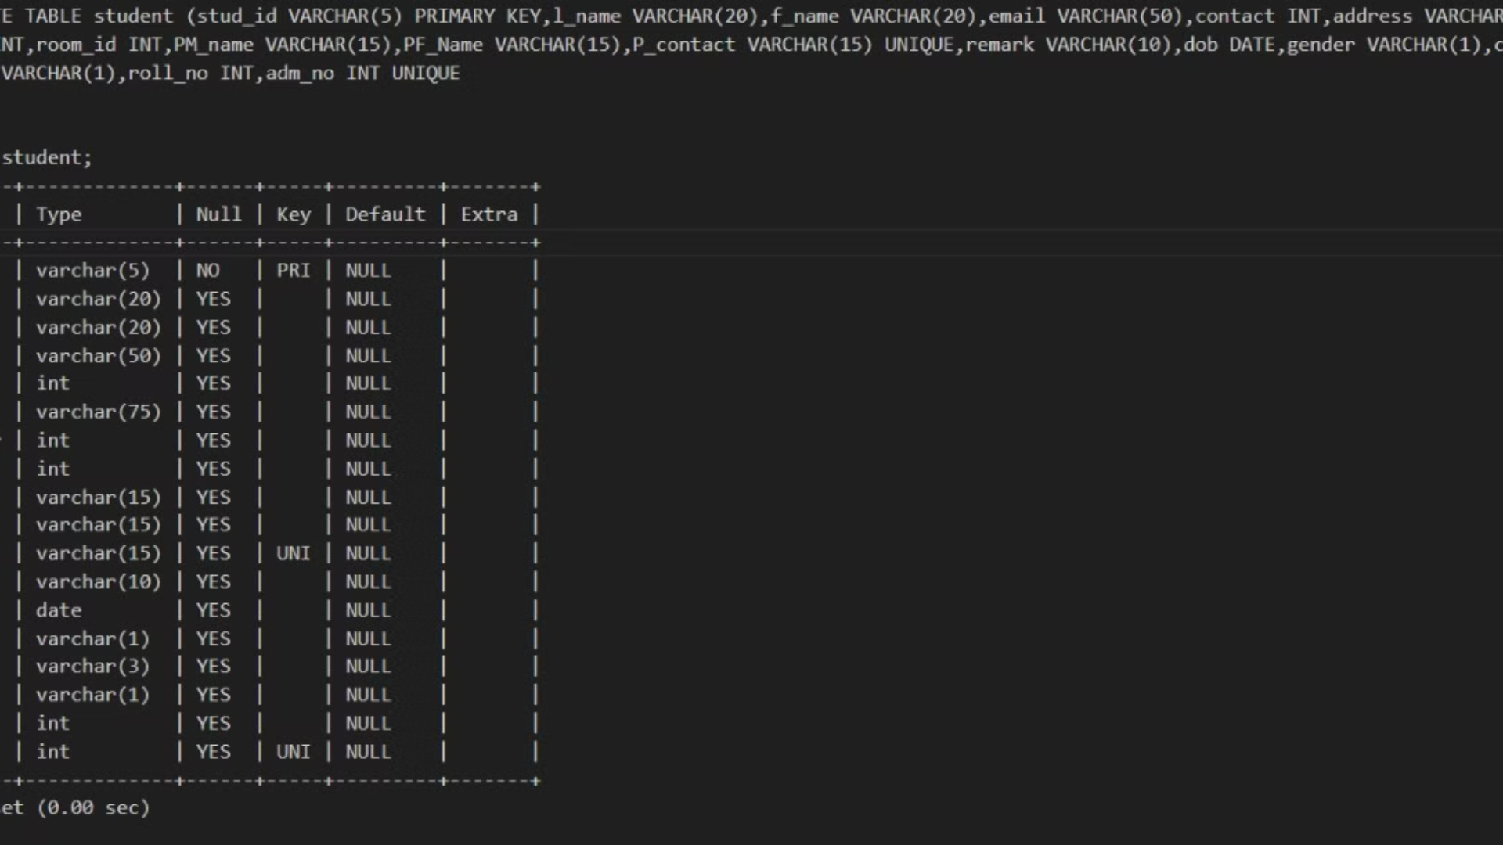

Slide 8
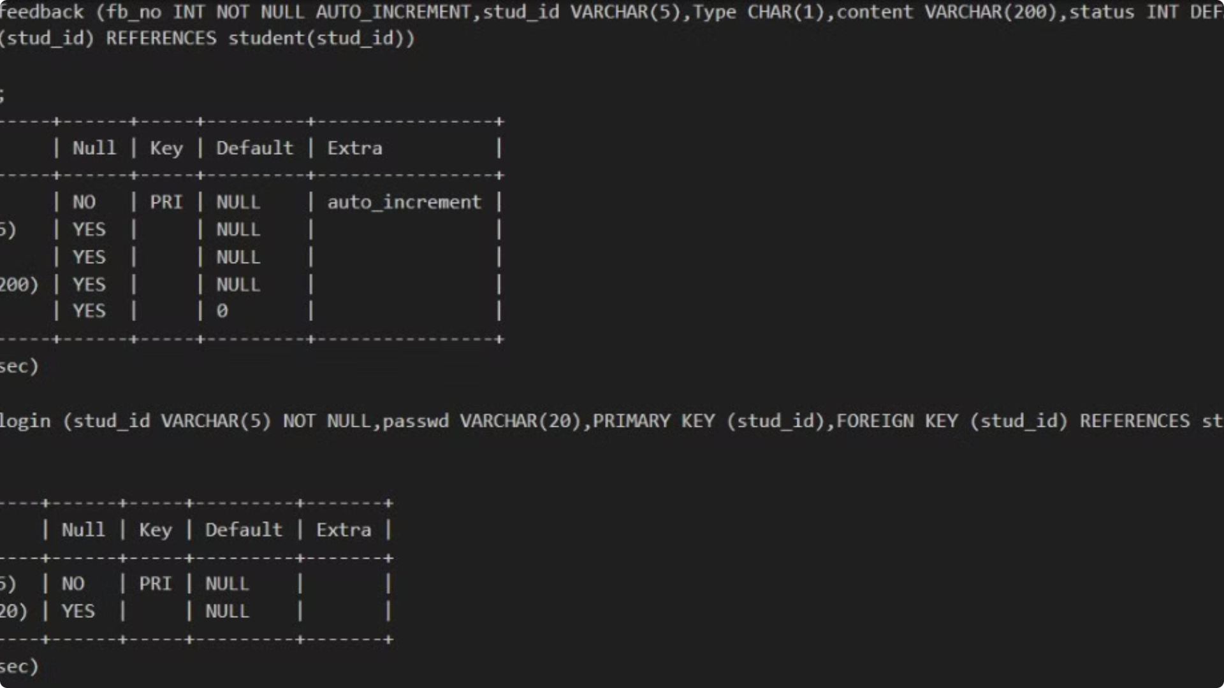

Slide 9
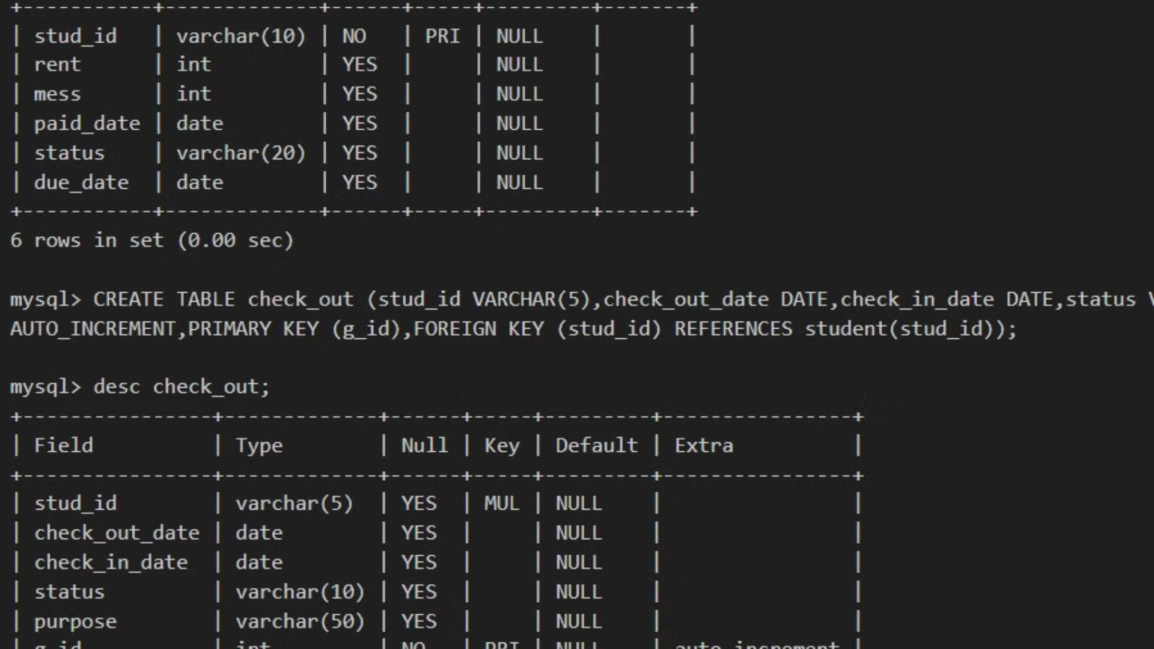

Slide 10
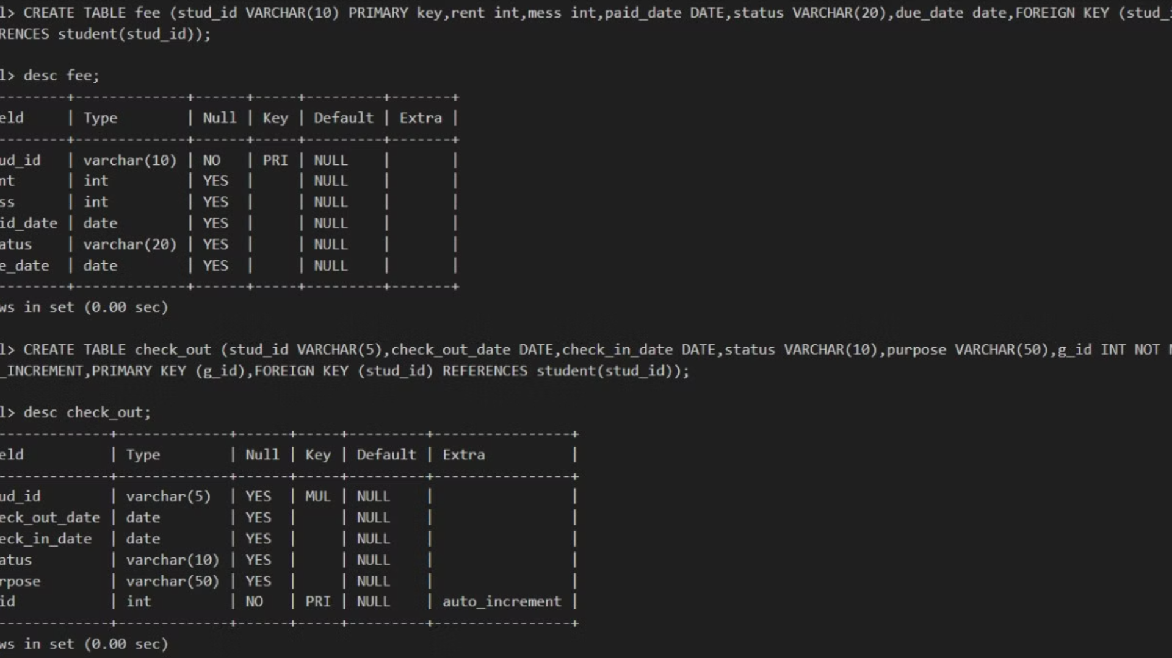

Slide 11
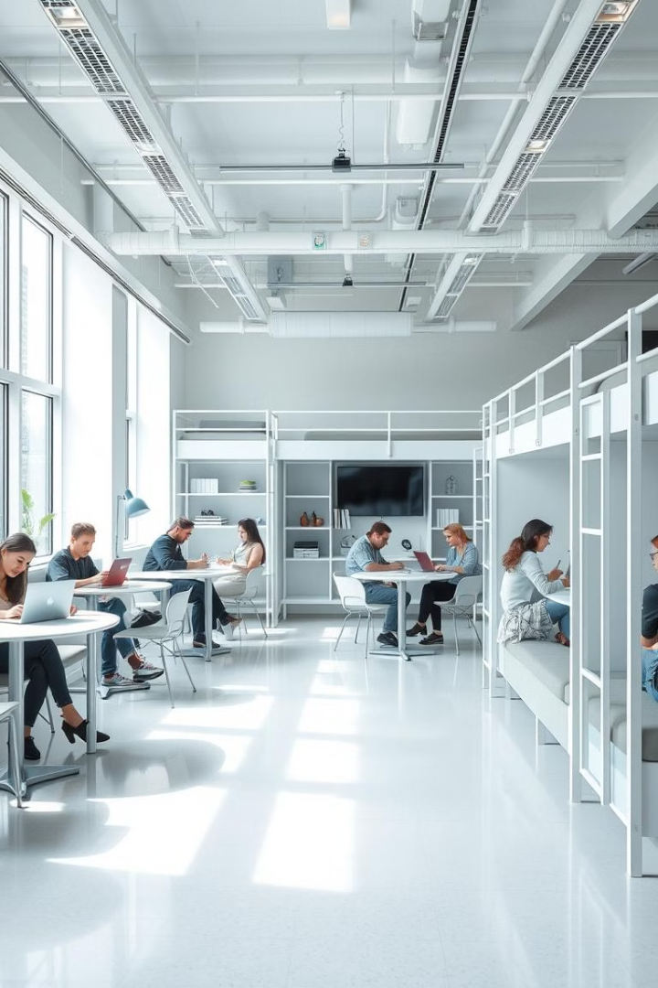
Conclusion: Enhancing Hostel Life through Technology
The Hostel Management System seamlessly integrates technology to empower both students and wardens, fostering a more efficient, engaged, and enriching hostel experience for all.

